Slide 1

Learning Objective
I will solve quadratic equations by factorising.
Enter quietly, please be ready with the following on your desk:
Whiteboard
Whiteboard marker
Exercise Book
Pencil, pen, ruler and red pen
Diary
Calculator
Device – charged or borrowed from Library before maths

Slide 2

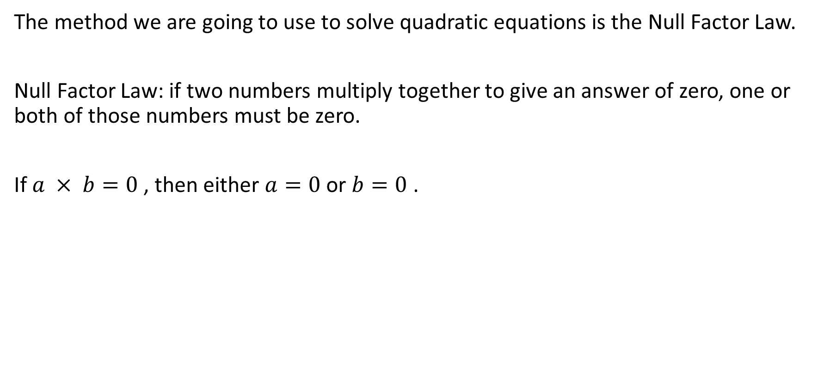
Daily Review
CFU 1
What is the null factor law?
The method we are going to use to solve quadratic equations is the Null Factor Law.
Null Factor Law: if two numbers multiply together to give an answer of zero, one or both of those numbers must be zero.
If $a × b=0$, then either $a=0$ or $b=0$ .

Slide 3
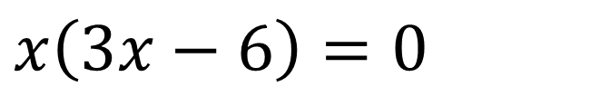




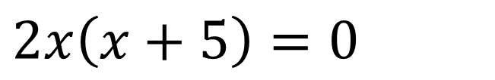
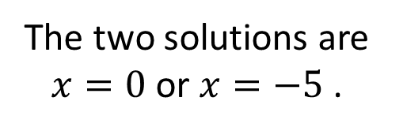

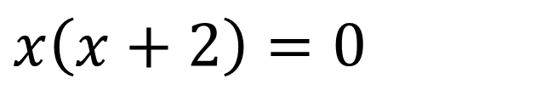


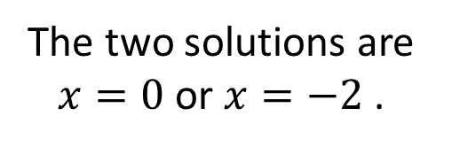








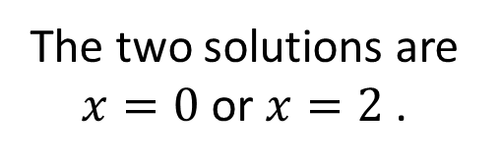
Daily Review
Null Factor Law: if two numbers multiply together to give an answer of zero, one or both of those numbers must be zero.
Solve the following quadratic equations using the null factor law.
$$x\left(x+2\right)=0$$
$$2x\left(x+5\right)=0$$
$$x\left(3x−6\right)=0$$
$$x=0$$
OR
$$x+2=0$$
$$2x=0$$
OR
$$x+5=0$$
$$x=0$$
OR
$$3x−6=0$$
-2
-2
$$÷2$$
$$÷2$$
-5
-5
+6
+6
$$x=−2$$
$$x=0$$
$$x=−5$$
$$3x=6$$
$$÷3$$
$$÷3$$
The two solutions are $x=0$or $x=−2$ .
The two solutions are $x=0$or $x=−5$ .
$$x=2$$
The two solutions are $x=0$or $x=2$.

Slide 4
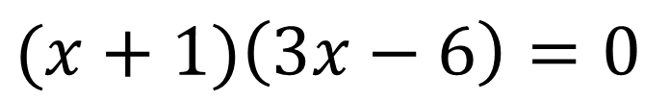


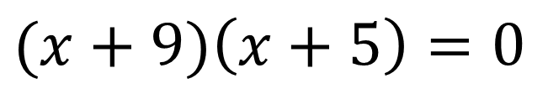
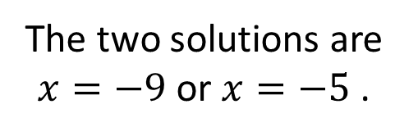
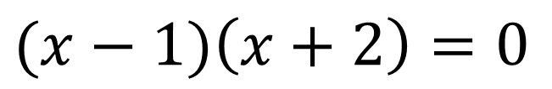

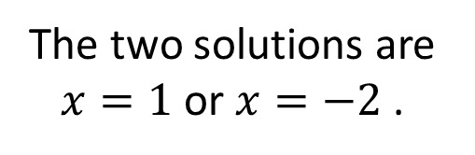






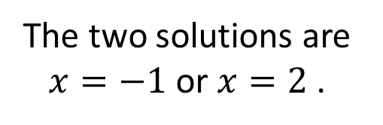
Daily Review
Null Factor Law: if two numbers multiply together to give an answer of zero, one or both of those numbers must be zero.
Solve the following quadratic equations using the null factor law.
$$(x−1)\left(x+2\right)=0$$
$$(x+9)\left(x+5\right)=0$$
$$(x+1)\left(3x−6\right)=0$$
$$x−1=0$$
OR
$$x+2=0$$
$$x+9=0$$
OR
$$x+5=0$$
$$x+1=0$$
OR
$$3x−6=0$$
+1
+1
-2
-2
$$−9$$
$$−9$$
-5
-5
-1
-1
+6
+6
$$x=1$$
$$x=−2$$
$$x=−9$$
$$x=−5$$
$$x=−1$$
$$3x=6$$
$$÷3$$
$$÷3$$
The two solutions are $x=1$or $x=−2$ .
The two solutions are $x=−9$or $x=−5$ .
$$x=2$$
The two solutions are $x=−1$or $x=2$.

Slide 5

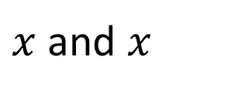










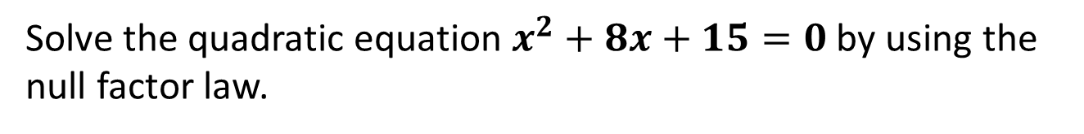

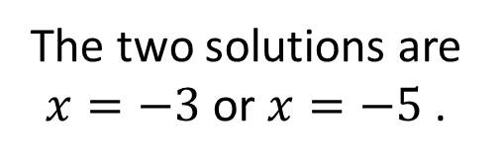


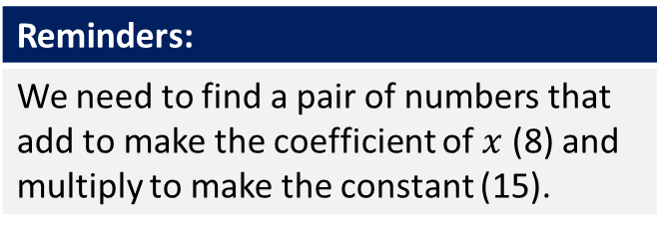

Daily Review
Reminders:
We need to find a pair of numbers that add to make the coefficient of $x$ (8) and multiply to make the constant (15).
Solve the quadratic equation $x^{2}+8x+15=0$by using the null factor law.
$$x^{2}+8x+15$$
$x$ and $x$
What do you multiply together to make $x^{2 }$?
$$x$$
$$3$$
1 and 15
3 and 5
What do you multiply together to make 15?
$$x$$
$$x^{2}$$
$$3x$$
3 and 5
What do you also add together to make 8?
$$5$$
$$5x$$
$$15$$
$$x^{2}+8x+15=\left(x+3\right)\left(x+5\right)=0$$
$$x+3=0$$
OR
$$x+5=0$$
$$−3$$
$$−3$$
-5
-5
$$x=−3$$
$$x=−5$$
The two solutions are $x=−3$or $x=−5$ .

Slide 6








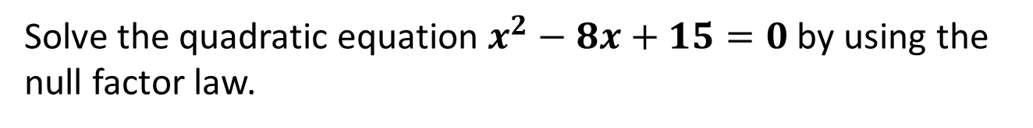

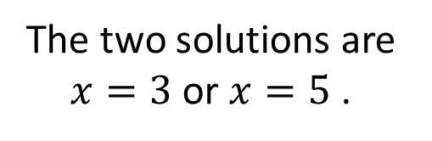


Concept Development
Reminders:
We need to find a pair of numbers that add to make the coefficient of $x$ (8) and multiply to make the constant (15).
Solve the quadratic equation $x^{2}−8x+15=0$by using the null factor law.
$$x^{2}−8x+15$$
$x$ and $x$
What do you multiply together to make $x^{2 }$?
$$x$$
$$−3$$
1 and 15
3 and 5
What do you multiply together to make 15?
$$x$$
$$x^{2}$$
$$−3x$$
-3 and -5
What do you also add together to make -8?
$$−5$$
$$−5x$$
$$15$$
$$x^{2}−8x+15=\left(x−3\right)\left(x−5\right)=0$$
$$x−3=0$$
OR
$$x−5=0$$
$$+3$$
$$+3$$
+5
+5
$$x=3$$
$$x=5$$
The two solutions are $x=3$or $x=5$ .

Slide 7
Concept Development
Reminders:
We need to find a pair of numbers that add to make the coefficient of $x$ (8) and multiply to make the constant (15).
Solve the quadratic equation $x^{2}−8x+15=0$by using the null factor law.
$$x^{2}−8x+15$$
$x$ and $x$
What do you multiply together to make $x^{2 }$?
$$x$$
$$−3$$
1 and 15
3 and 5
What do you multiply together to make 15?
$$x$$
$$x^{2}$$
$$−3x$$
-3 and -5
What do you also add together to make -8?
$$−5$$
$$−5x$$
$$15$$
$$x^{2}−8x+15=\left(x−3\right)\left(x−5\right)=0$$
$$x−3=0$$
OR
$$x−5=0$$
$$+3$$
$$+3$$
+5
+5
$$x=3$$
$$x=5$$
The two solutions are $x=3$or $x=5$ .

Slide 8




Daily Review
Sketch the graph of the following equation $y =5x2+4.$
We want to graph the equation $y =5x2+4$using integer
values of x from -3 to 2. Substitute each number into the equation to find the
points we need. (Use a scientific calculator and brackets to help you do this.)
$$y =5x2+4$$
$$y =5\left(−3\right)2+4$$
$=5\left(9\right)+4$
$=49$
$$y =5x2+4$$
$$y =5\left(−1\right)2+4$$
$=5\left(1\right)+4$
$=9$
$$y =5x2+4$$
$$y =5\left(2\right)2+4$$
$=5(4)+4$
$=24$
x | -3 | -2 | -1 | 0 | 1 | 2
y | 49 | 24 | 9 | 4 | 9 | 24

Slide 9
Learning Objective
CFU 1
What will we learn?
I will solve quadratic equations using graphing.
CFU 2
What will we learn?
CFU 3
How will we know if we’ve been successful?
Success Criteria
CFU 4
How will we know if we’ve been successful?
I will be able to:
Factorise monic quadratic expressions with negatives.
Solve quadratic equations using the null factor law.

Slide 10
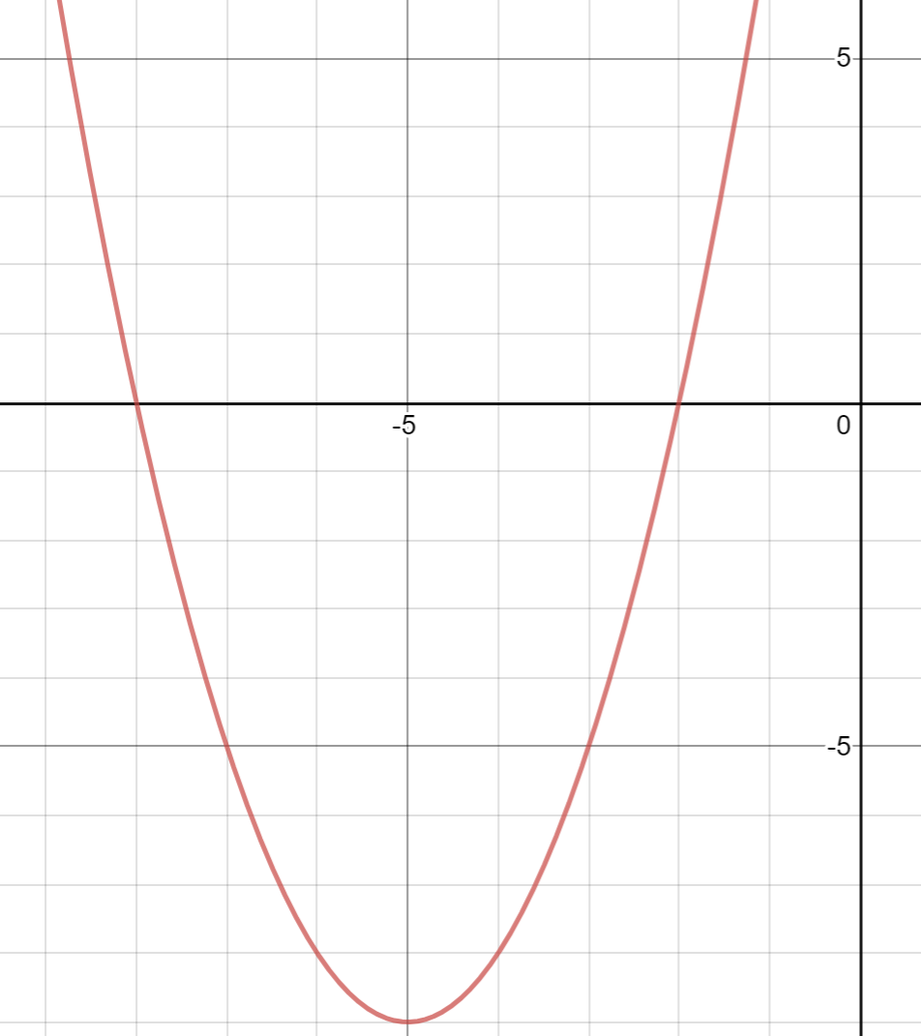


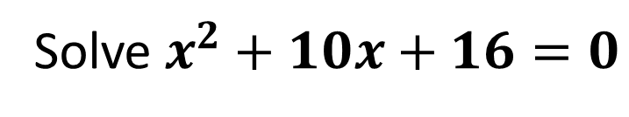




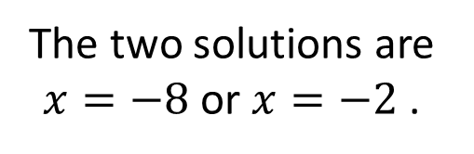
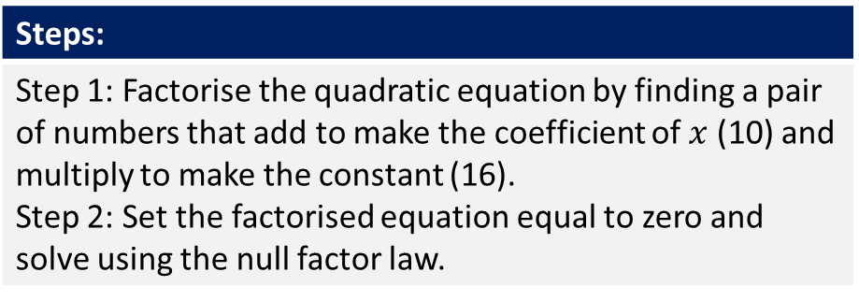

Activate Prior Knowledge
Steps:
Step 1: Factorise the quadratic equation by finding a pair of numbers that add to make the coefficient of $x$ (10) and multiply to make the constant (16). Step 2: Set the factorised equation equal to zero and solve using the null factor law.
Solve $x^{2}+10x+16=0$
Step 1: Adds to make 10 and multiplies to make 16
8 and 2
$$x^{2}+10x+16=\left(x+8\right)\left(x+2\right)$$
$$\left(x+8\right)\left(x+2\right)=0$$
Step 2:
$$x+8=0$$
OR
$$x+2=0$$
$$−8$$
$$−8$$
-2
-2
$$x=−8$$
$$x=−2$$
The two solutions are $x=−8$or $x=−2$ .

Slide 11
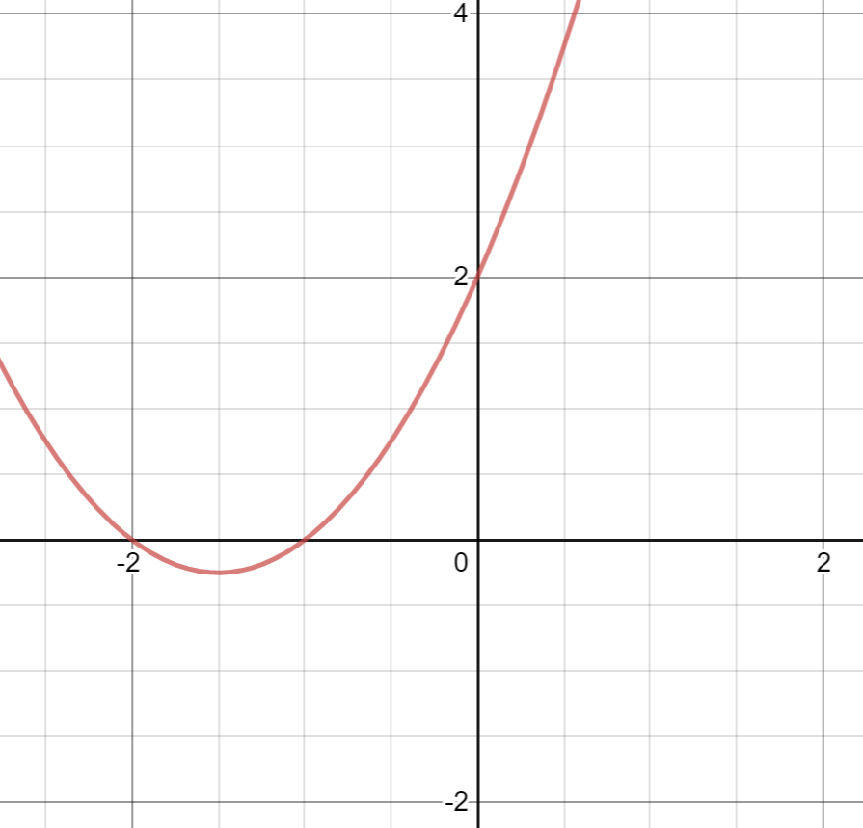
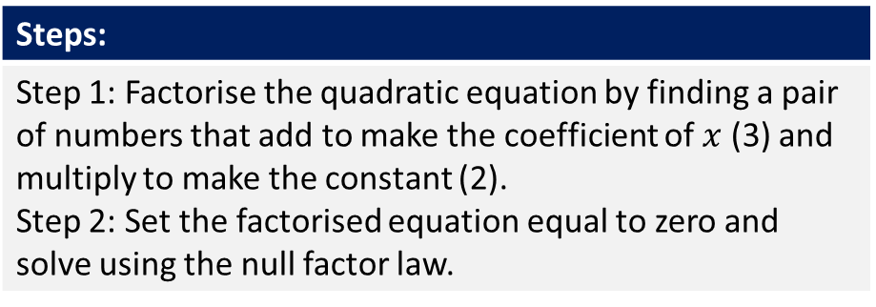

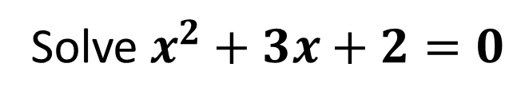




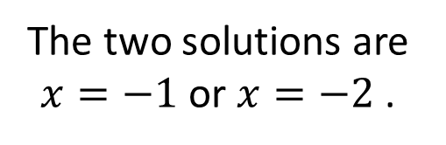
Daily Review
Steps:
Step 1: Factorise the quadratic equation by finding a pair of numbers that add to make the coefficient of $x$ (3) and multiply to make the constant (2). Step 2: Set the factorised equation equal to zero and solve using the null factor law.
Solve $x^{2}+3x+2=0$
Step 1: Adds to make 3 and multiplies to make 2
1 and 2
$$x^{2}+3x+2=\left(x+1\right)\left(x+2\right)$$
$$\left(x+1\right)\left(x+2\right)=0$$
Step 2:
$$x+1=0$$
OR
$$x+2=0$$
$$−1$$
$$−1$$
-2
-2
$$x=−−1$$
$$x=−2$$
The two solutions are $x=−1$or $x=−2$ .

Slide 12
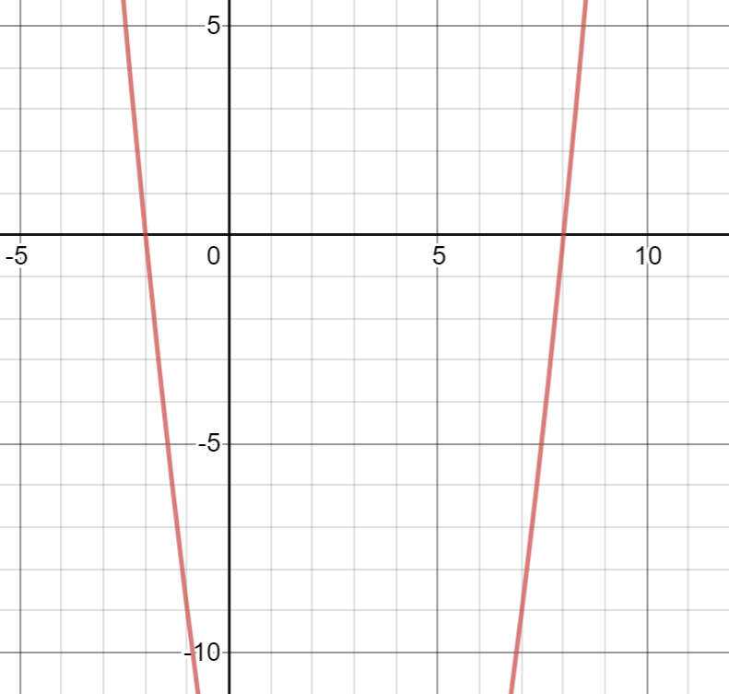
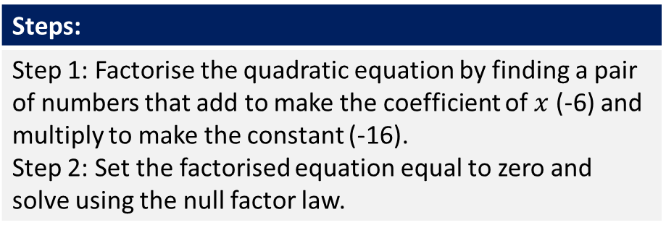

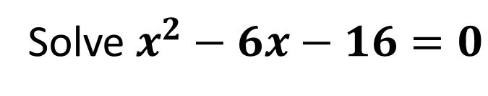




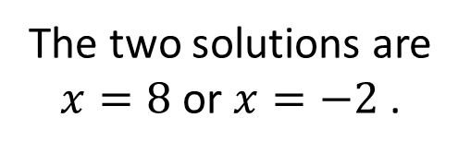
Skill Development/Guided Practice
Steps:
Step 1: Factorise the quadratic equation by finding a pair of numbers that add to make the coefficient of $x$ (-6) and multiply to make the constant (-16). Step 2: Set the factorised equation equal to zero and solve using the null factor law.
Solve $x^{2}−6x−16=0$
Step 1: Adds to make -6 and multiplies to make -16
-8 and 2
$$x^{2}−6x−16=\left(x−8\right)\left(x+2\right)$$
$$\left(x−8\right)\left(x+2\right)=0$$
Step 2:
$$x−8=0$$
OR
$$x+2=0$$
$$+8$$
$$+8$$
-2
-2
$$x=8$$
$$x=−2$$
The two solutions are $x=8$or $x=−2$ .

Slide 13
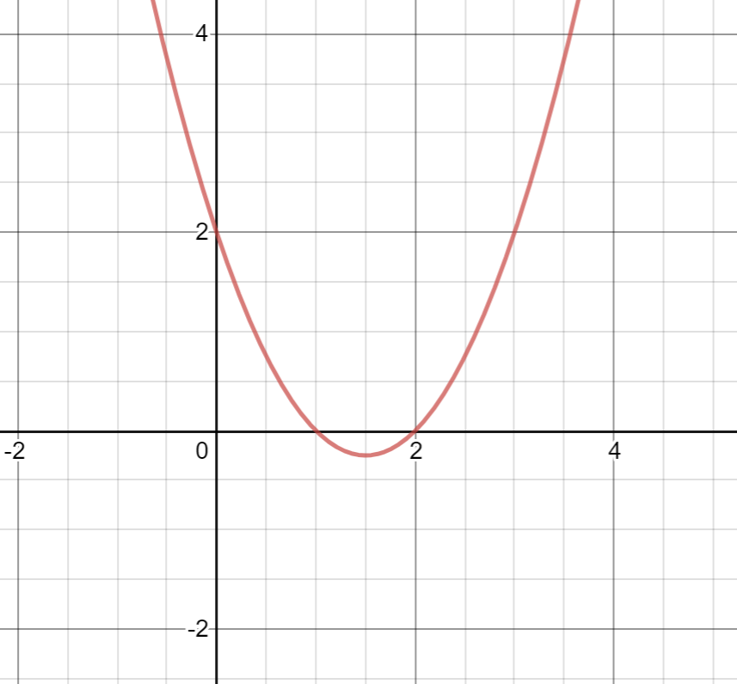

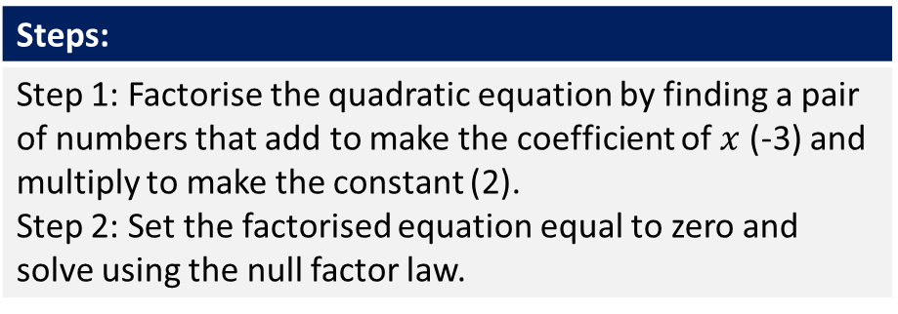


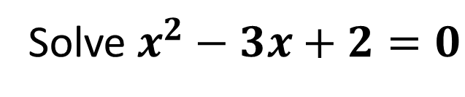




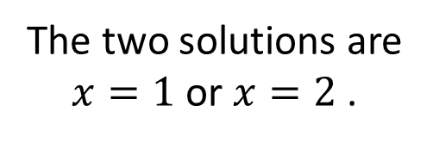
Skill Development/Guided Practice
Steps:
Step 1: Factorise the quadratic equation by finding a pair of numbers that add to make the coefficient of $x$ (-3) and multiply to make the constant (2). Step 2: Set the factorised equation equal to zero and solve using the null factor law.
Solve $x^{2}−3x+2=0$
Step 1: Adds to make -3 and multiplies to make 2
- 1 and -2
$$x^{2}−3x+2=\left(x−1\right)\left(x−2\right)$$
$$\left(x−1\right)\left(x−2\right)=0$$
Step 2:
$$x−1=0$$
OR
$$x−2=0$$
$$+1$$
$$+1$$
+2
+2
$$x=−1$$
$$x=2$$
The two solutions are $x=1$or $x=2$ .

Slide 14
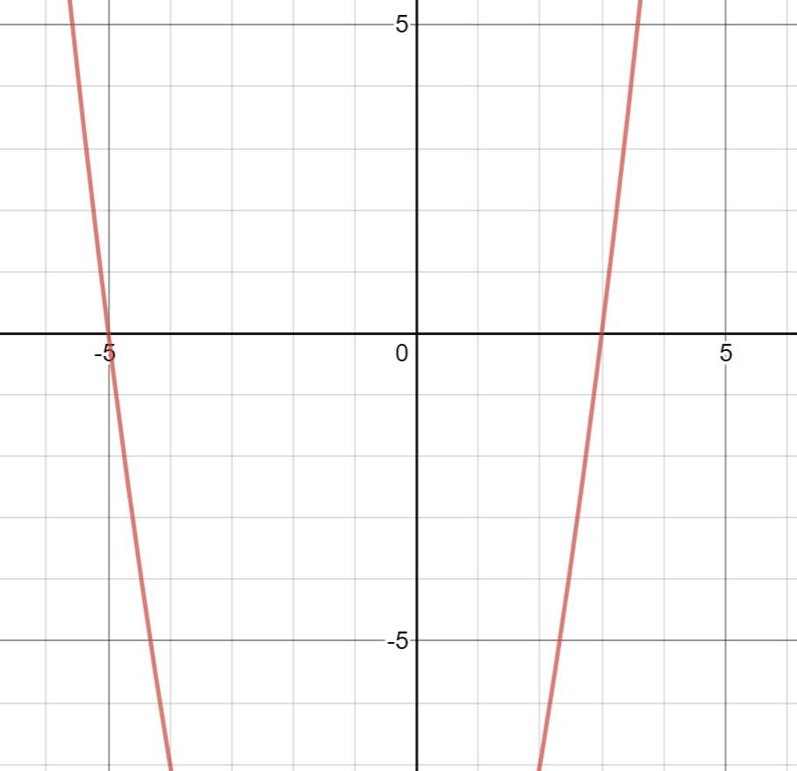

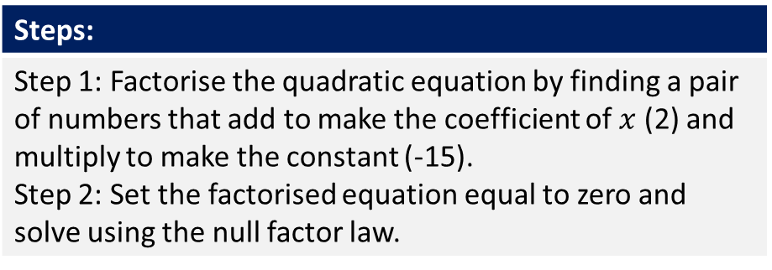


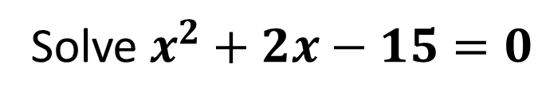




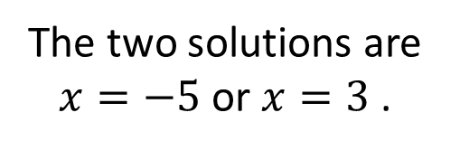
Skill Development/Guided Practice
Steps:
Step 1: Factorise the quadratic equation by finding a pair of numbers that add to make the coefficient of $x$ (2) and multiply to make the constant (-15). Step 2: Set the factorised equation equal to zero and solve using the null factor law.
Solve $x^{2}+2x−15=0$
Step 1: Adds to make 2 and multiplies to make -15
5 and -3
$$x^{2}+2x−15=\left(x+5\right)\left(x−3\right)$$
$$\left(x+5\right)\left(x−3\right)=0$$
Step 2:
$$x+5=0$$
OR
$$x−3=0$$
$$−5$$
$$−5$$
+3
+3
$$x=−5$$
$$x=3$$
The two solutions are $x=−5$or $x=3$ .

Slide 15
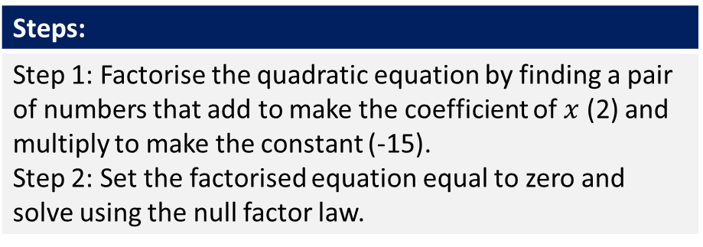
Independent Practice
Steps:
Step 1: Factorise the quadratic equation by finding a pair of numbers that add to make the coefficient of $x$ (2) and multiply to make the constant (-15). Step 2: Set the factorised equation equal to zero and solve using the null factor law.
Solve $x^{2}+2x−15=0$
Step 1: Adds to make 2 and multiplies to make -15
5 and -3
$$x^{2}+2x−15=\left(x+5\right)\left(x−3\right)$$
$$\left(x+5\right)\left(x−3\right)=0$$
Step 2:
$$x+5=0$$
OR
$$x−3=0$$
$$−5$$
$$−5$$
+3
+3
$$x=−5$$
$$x=3$$
The two solutions are $x=−5$or $x=3$ .

